Slide 1
CS F372 Operating Systems
04 – Process Management
Chapter : 3
Sections : 3.1 and 3.2

Slide 2
Process
A process is a program in execution
It is a unit of work within the system
Program is a passive entity, process is an active entity
Process needs resources to accomplish its task
CPU, memory, I/O, files
Initialization data
Process termination requires reclaim of any reusable resources

Slide 3
Process
Typically system has many processes, some user, some operating system running concurrently on one or more CPUs
Concurrency by multiplexing the CPUs among the processes / threads
Two processes associated with the same program
Editor program
Similar text sections
Different data sections
A process can spawn processes

Slide 4
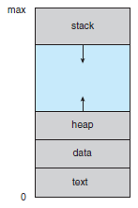
Process
A process includes:
Text, Stack, Data, Heap section, Program counter, Register contents
The program code, also called text section
Current activity including program counter, processor registers
Stack containing temporary data
Function parameters, return addresses, local variables
Data section containing global variables
Heap containing memory dynamically allocated during run time

Slide 5
Process States
As a process executes, it changes state
State – what the process currently does
new: The process is being created
running: Instructions are being executed
waiting: The process is waiting for some event to occur
ready: The process is waiting to be assigned to a processor
terminated: The process has finished execution

Slide 6
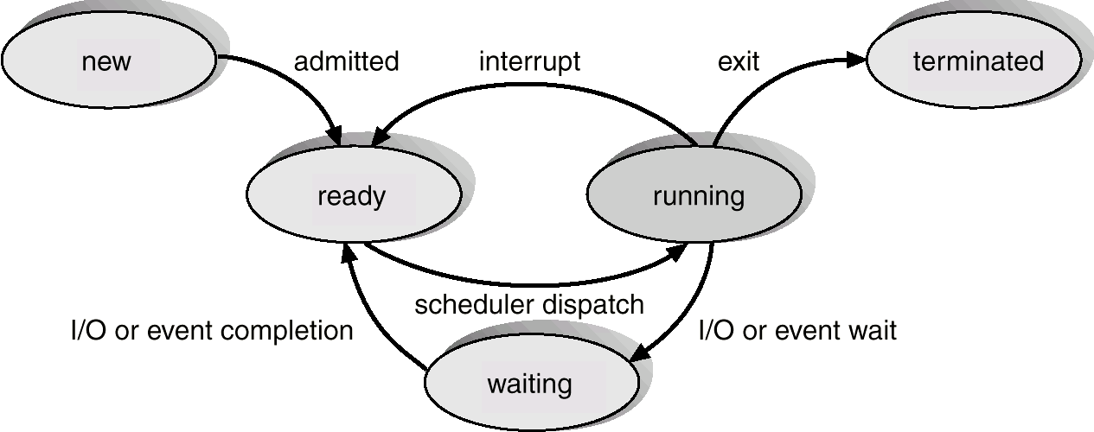
5-state Process State Transition Diagram

Slide 7
Process Creation
Submission of a batch job
User logs on
Process created to provide a service such as printing
Process creates another process

Slide 8
Process Termination
Normal completion
Batch job issues Halt instruction
User logs off
Quit an application
Time limit exceeded
Error and fault conditions
Memory unavailable
Bounds violation
Protection error
example write to read-only file
Arithmetic error
Time overrun
process waited longer than a specified maximum for an event

Slide 9
Process Termination
I/O failure
Invalid instruction
happens when try to execute data
Privileged instruction
Data misuse
Operating system intervention
such as when deadlock occurs
Parent terminates so child processes terminate
Parent request

Slide 10
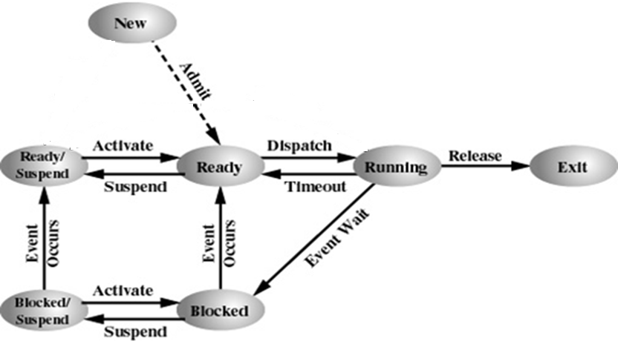
7 state Process state transition with two suspended states
Activate: Swap in
Suspend: Swap out

Slide 11
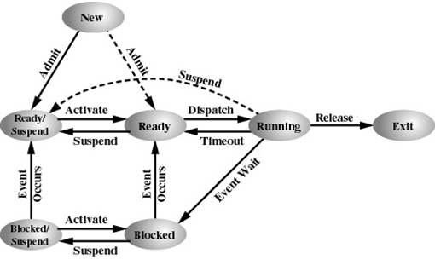
7 state Process state transition with two suspended states
Activate: Swap in
Suspend: Swap out

Slide 12
Process state transition with two suspended states
The OS can swap out processes, i.e. transfer them to disk due to lack of primary memory. Two states are added.
Blocked suspend
Processes in blocked state but are swapped out of main memory and placed in the disk
When event occurs it goes to ready suspended
Ready suspend
Processes in the ready or running state but are swapped out of main memory and placed in the disk
The process will transition back to ready state whenever the process is again brought onto the main memory

Slide 13
Process Control Block (PCB)
Maintains information about each process in the operating system
Also called task control block (TCB)
Information in PCB
Process state
New, ready, running etc.
Program counter
Address of next instruction to be executed
CPU registers
Accumulator, GPRs, Flag, Stack pointer, index registers

Slide 14
Process Control Block (PCB)
CPU scheduling information
Process priority, pointers to scheduling queues, scheduling parameters
Memory-management information
Value of base and limit registers, page tables or segment tables
Accounting information
Amount of CPU time used, Process numbers
I/O status information
List of I/O devices allocated, List of open files

Slide 15
Memory Protection
In order to have memory protection, two registers are used that determine the range of legal addresses a program may access:
Base register – holds the smallest legal physical memory address
Limit register – contains the size of the range

Slide 16
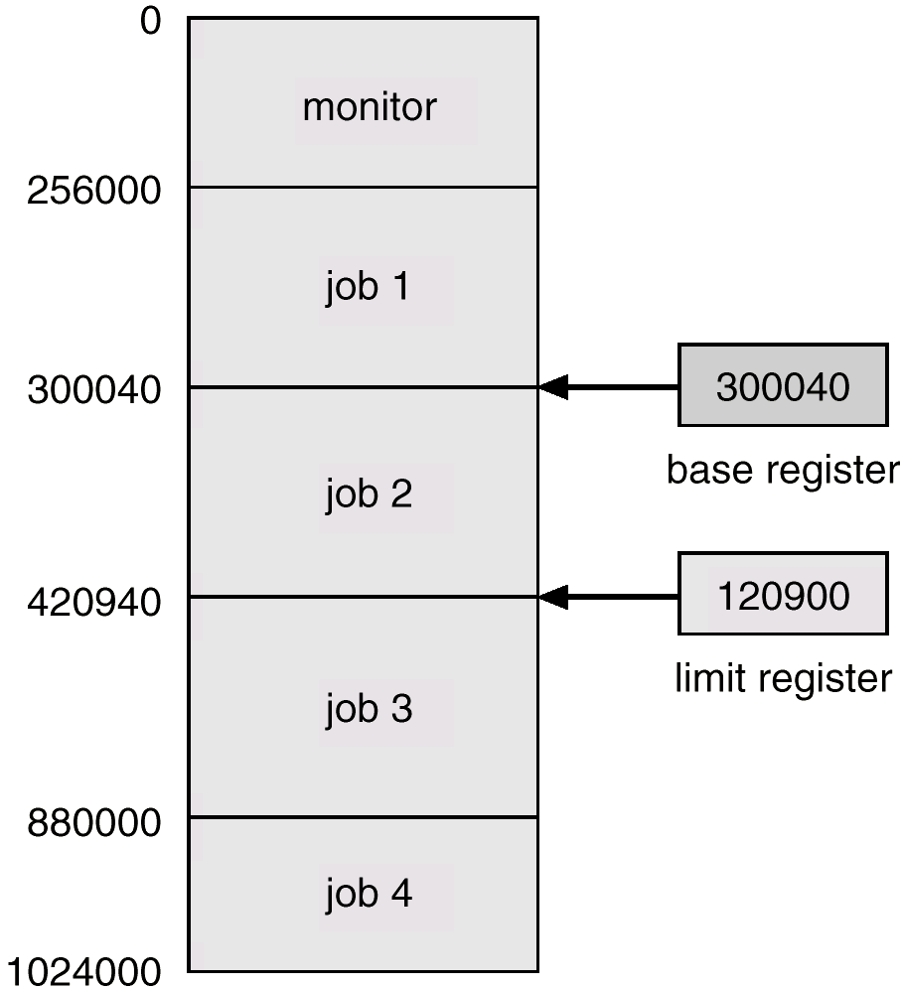
Use of A Base and Limit Register

Slide 17
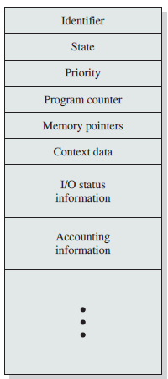
Process Control Block (PCB)

Slide 18
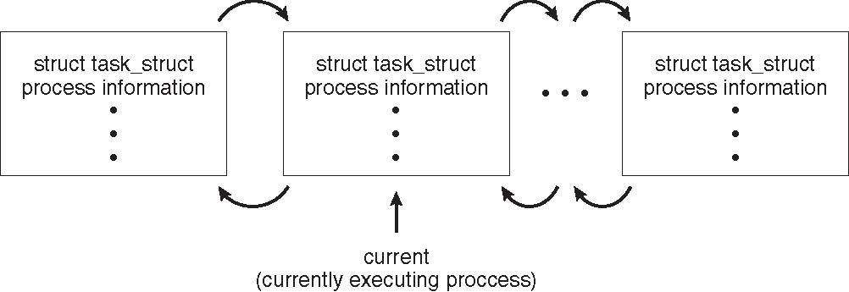
PCB Representation in Linux
Represented by the C structure task_struct pid t_pid; /* process identifier */ long state; /* state of the process */ unsigned int time_slice /* scheduling information */ struct task_struct *parent; /* this process’s parent */ struct list_head children; /* this process’s children */ struct files_struct *files; /* list of open files */ struct mm_struct *mm; /* address space of this process */

Slide 19
Process Scheduling
Maximize CPU utilization
In multi-programmed systems, some process must run at all times, to increase CPU utilization
In time-sharing systems, CPU must be switched between processes to increase interaction
If there are many processes, only one can use the CPU, the rest must wait
Process scheduler selects among available processes for execution on CPU

Slide 20
Process Scheduling Queues
Job queue – set of all processes in the system
Ready queue – set of all processes residing in main memory, ready and waiting to execute
Device queue – set of processes waiting for an I/O device.
Each queue has a queue header that contains pointers to the first and final PCBs in the list
Process migrates between the various queues

Slide 21
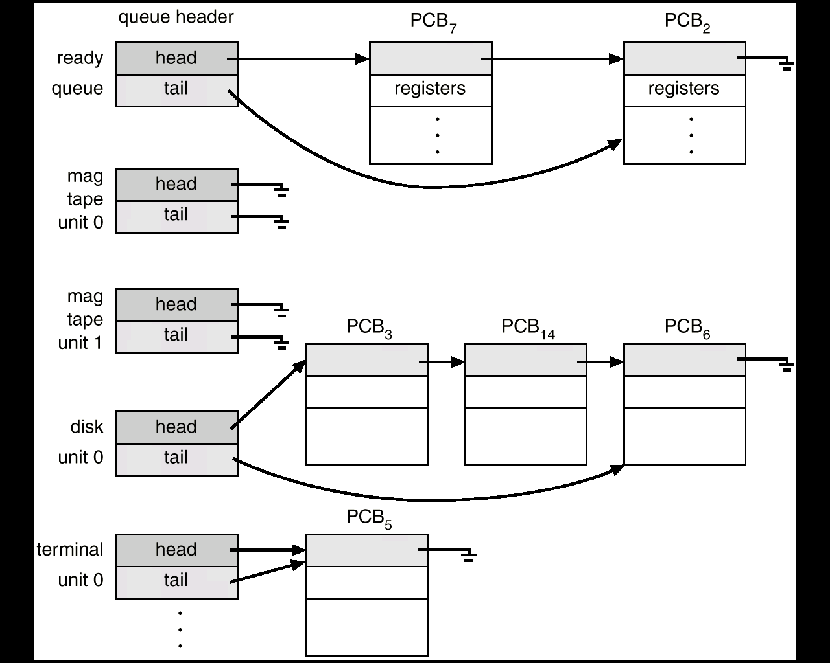
Ready Queue And Various I/O Device Queues

Slide 22
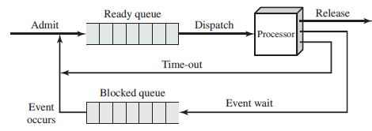
Representation of Process Scheduling
Queueing diagram represents queues, resources, flows

Slide 23
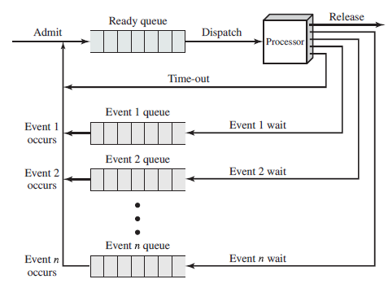
Representation of Process Scheduling

Slide 24
Schedulers
Scheduler
A process migrates among various scheduling queues during its lifetime
OS must select processes from the queues in some fashion
Selection is done by a scheduler
Types
Short-term scheduler (or CPU scheduler)
Long-term scheduler (or job scheduler)
Medium-term scheduler

Slide 25
Schedulers
Short-term scheduler
CPU scheduler
Selects from among processes that are ready to execute (ready queue) and allocates CPU
Short-term scheduler is invoked frequently (once every 100 milliseconds)
A process may execute for only a few milliseconds before waiting for an I/O request
Short time between executions ⇒ must be fast
Sometimes the only scheduler in a system

Slide 26
Schedulers
If it takes 10 milliseconds to decide to execute a process for 100 milliseconds, then what % of the CPU time is being used for scheduling the work?
Ans:
10/(100 + 10) = 9 percent of the CPU is being used
(wasted) simply for scheduling the work

Slide 27
Schedulers
Long-term scheduler
Job scheduler
Selects which processes should be brought into the ready queue
Long-term scheduler is invoked infrequently (seconds, minutes) ⇒ (may be slow)
The long-term scheduler controls the degree of multiprogramming
Processes can be described as either
I/O-bound process – spends more time doing I/O than computations, short CPU bursts
CPU-bound process – spends more time doing computations; very long CPU bursts
Long-term scheduler strives for good process mix

Slide 28
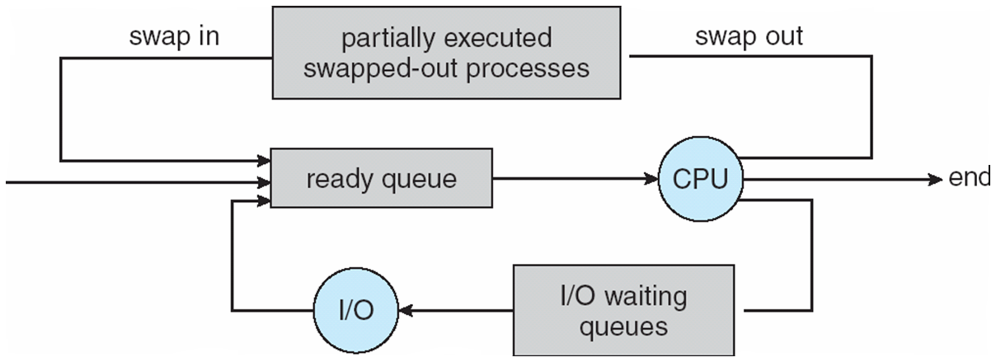
Medium Term Scheduling
Medium-term scheduler
can be added if degree of multiprogramming needs to modified
Remove process from memory, store on disk, bring back from disk to memory to continue execution: swapping in and swapping out

Slide 29
Context Switch
Context of a process
Represented in the PCB
Includes the value of CPU registers, process state and memory management information, etc.,
Context switch
Necessary when interrupt occurs (timer /hardware /software)
The OS save the state of the old process in PCB
Load the state (state restore) for the new process

Slide 30
Context Switch
Context-switch time is overhead
The system does no useful work while switching
The more complex the OS and the PCB ➔ the longer the context switch

Slide 31
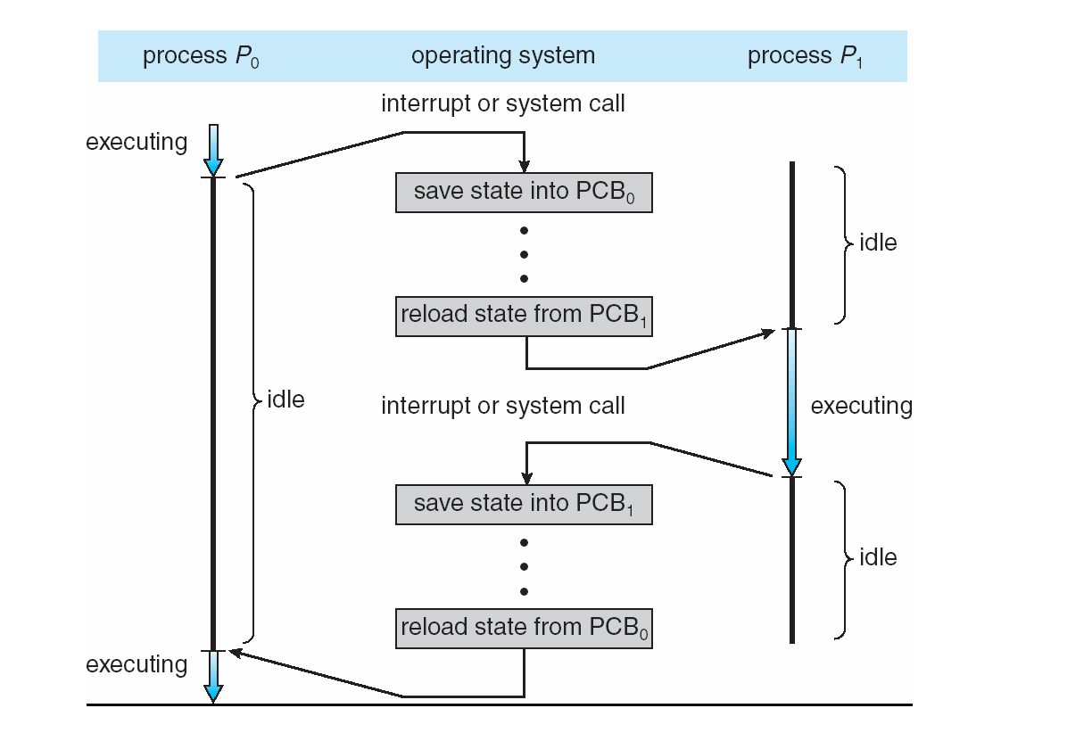
CPU Switch From Process to Process

Slide 32
Threads & advantages
Lightweight process
Single process – many threads
Each thread has thread ID, program counter, a register set and a stack
Shares its code section, data section and other OS resources with other threads of the same process
Advantages
Responsiveness
Resource Sharing
Economy

Slide 33
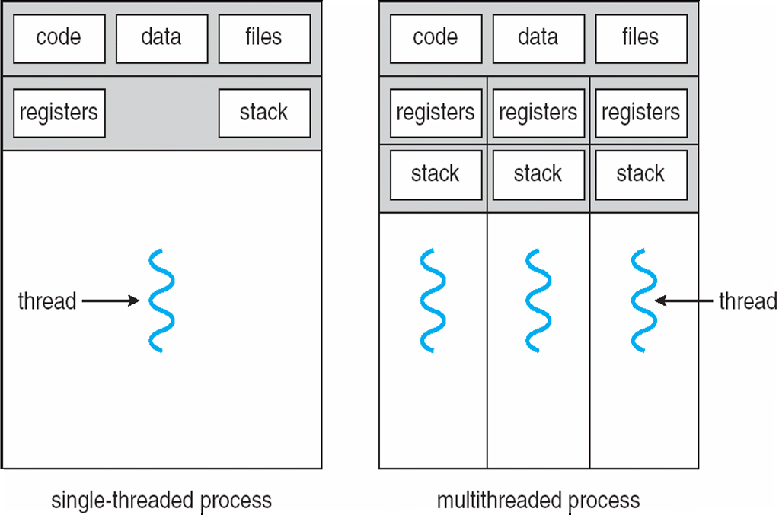
Single threaded vs multithreaded process

